Slide 1
European Regulatory Environment (just a part!)
Per Christensen, ECO Director
CEPT Workshop on European Spectrum Management and Numbering
5 April 2016

Slide 2
European regulatory framework for radio spectrum and equipment

Slide 3
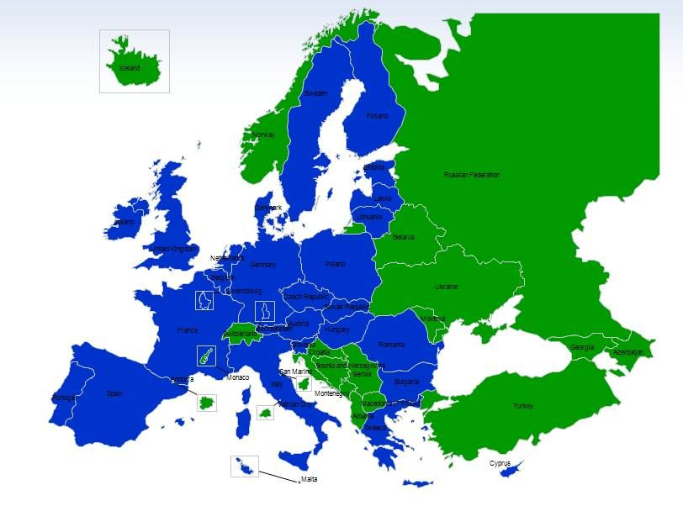
Roles of the three European regulatory organizations
European Commission:
Single market issues
Binding regulations based on the technical expertise of CEPT/ECC
and harmonised standards of ETSI (28 Member States)
CEPT/ECC:
Consensus and voluntary character
Spectrum designation to systems/applications and technical conditions for its use
(48 member countries)
ETSI:
European Harmonised standards (EN) for radio equipment
‘System Reference Documents’ (SRDoc) which inform and trigger much of the CEPT/ECC work
(750 industry members &
and European national regulators)

Slide 4
CEPT footprint: all EU Member States + rest of Europe
EU states shown in blue

Slide 5
ECC: Electronic Communications Committee
Works towards common regulatory policies in Europe.
Harmonise efficient use of the radio spectrum, satellite orbits and numbering resources.
Develop European common positions and proposals, for use in the framework of ITU-R (WRC) to promote the European interests on a worldwide basis.
Cooperation with other bodies.

Slide 6
ETSI: European Telecommunications Standards Institute
ETSI was created in 1988.
Not-for-profit organisation; more than 750 members from 63 countries.
Recognized by the European Union as a European Standards Organisation.
Produces standards and SRDocs for ICT, including fixed, mobile, radio, converged, broadcast and internet technologies.

Slide 7
European Commission: “DG CONNECT” and “DG GROWTH”
The Directorate General for Communications Networks, Content & Technology.
Radio Spectrum Decision
Radio Spectrum Policy Programme
Radio Spectrum Committee
Radio Spectrum Policy Group
The Directorate General for Internal Market, Industry, Entrepreneurship and SMEs.
Radio and Telecommunication Terminal Equipment Directive
Telecommunications Conformity Assessment and Market Surveillance Committee.

Slide 8
Objective of the EU's Radio Spectrum Policy
Support the internal market for wireless services.
Foster innovation in electronic communications and other sectors.
Main areas:
Identification of needs for spectrum coordination.
Harmonisation of spectrum usage.
Establishment of policy priorities.
Setting the regulatory environment for access to radio spectrum.

Slide 9
Radio Spectrum Decision
Defines policy and regulatory tools to ensure the coordination of policy approaches and harmonised conditions for the availability and efficient use of radio spectrum for the internal market.
Allows the Commission to adopt implementing decision to harmonise technical conditions with regard to the availability and efficient use of spectrum for the proper functioning of the single market.
The Commission may issue mandates to the ECC for the preparation of such technical implementing measures.

Slide 10
Radio Spectrum Policy Group (RSPG)
A high level advisory policy group of member states
Chaired by a member state; changes every two years
Commission provide the secretariat
Provides a top-level policy focus and context for Commission to recognise MS views
Has a work programme, reviewed every 1-2 years
Meets 3 times per year
Member state commitment to working groups quite high.

Slide 11
Radio Spectrum Committee (RSC)
A committee that makes decisions which bind EU member states.
Chaired by the Commission.
Mandates to CEPT.
Commission takes initiatives, member states and Commission have to agree on outcomes.
RSC can take Decisons, but some regulations need to be agreed by EU Council and Parliament – e.g. RSPP.
RSC meets 4 time per year.

Slide 12
Radio Spectrum Policy Programme (RSPP)
The first RSPP was established in 2012 by European Parliament/Council Decision for the period 2012-15.
Roadmap for how Europe can translate political priorities into strategic policy objectives for radio spectrum use.
Although being a policy programme, the current RSPP is a legally binding Decision for Member States in its entirety.
Focused largely on targeted actions to support the roll out of high speed Wireless Broadband and the Radio Spectrum inventory.

Slide 13
Telecommunications Conformity Assessment and Market Surveillance Committee.
The TCAM Committee assists the Commission in the management of the Radio and Telecommunication Terminal Equipment Directive.
Regulates the requirements that radio equipment must meet in order to be placed on the market in the European Union.
The EC, after consultation with TCAM, prepares standardisation requests for development of Harmonised Standards.

Slide 14
Cooperation between CEPT and ETSI
MoU between ETSI and the ECC for co-operation in the development of their interrelated respective deliverables.
Supporting European regulation and legislation by producing Harmonised Standards.
Make sure that ECC and ETSI deliverables do not contradict each other: ETSI produces System Reference documents - ECC carries out sharing studies.
Results of these sharing studies should be mutually
acceptable and implemented consistently.

Slide 15
European regulatory framework for radio spectrum and equipment

